Slide 1

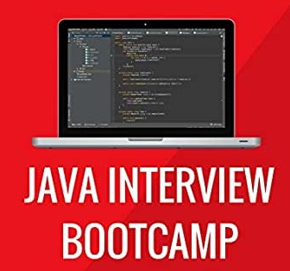
JAVA INTERVIEW module
Lecture 6

Slide 2

Today’s Agenda
Identifiers
Reserved Words , Keywords & Literals
Their Difference
Tricky Interview Questions

Slide 3
What Are Identifiers ?
Any name in java program is called an identifier .
In other words we can say words used for identification purposes are called identifiers.
They are used for :
class
interface
method
variable name
label name
package name

Slide 4
Rules For Identifiers
Rule 1
The only allowed characters in Java identifiers are
a to z
A to Z
0 to 9
$
_(Underscore)

Slide 5
Popular Interview Question
How many identifiers are there in the following code ?
class Sample{
public static void main(String [] args){
int x=10;
System.out.println(x);
}
}
Answer:
8

Slide 6
Rules For Identifiers
Rule 2
Identifiers can't start with digit i.e., 123name is not valid.
Rule 3
Java identifiers are case sensitive so name, Name, NAME all are
different variable names.

Slide 7
Rules For Identifiers
Rule 4
There is no length limit for java identifiers but it is not
recommended to take too lengthy identifiers.
Rule 5
We can't use reserved words as identifiers otherwise we
will get compilation error. i.e.,
int if = 20;
Here we will get compilation error.

Slide 8
Popular Interview Question
Will this program compile and run ?
class Test{
public static void main(String [] args){
int String = 10;
System.out.println(String);
}
}
Answer :
Yes

Slide 9
Rules For Identifiers
Rule 6
All predefined java class names and interface names can be
used as identifiers.

Slide 10
Popular Interview Question
Will this program compile and run?
class Emp
{
public int Emp;
public Emp(int Emp)
{
this.Emp=Emp;
}
}
class UseEmp
{
public static void main(String[] args)
{
Emp Emp=new Emp(10);
System.out.println(Emp.Emp);
}
}
ANSWER:
Yes , the code will compile and run as
java UseEmp
Output:
10

Slide 11
Popular Interview Question
Are they legal identifiers ?
int _a;
int $c;
int ______2_w;
int _$;
int this_is_a_very_detailed_name_for_an_identifier;
Answer:
Yes, all are legal

Slide 12
Popular Interview Question
Are they legal identifiers ?
int :b;
int -d;
int e#;
int .f;
int 7g;
int _;
Answer:
No , none of them is legal !
Special Point:The symbol of underscore has become a keyword since Java 9 , so
it also cannot be used as a variable name

Slide 13
What Are Reserved Words ?
Java language has reserved some words to represent special functionalities .
These words are called reserved words.
They can be briefly categorized into two parts :
Keywords(50) and
Reseved literals(3).

Slide 14
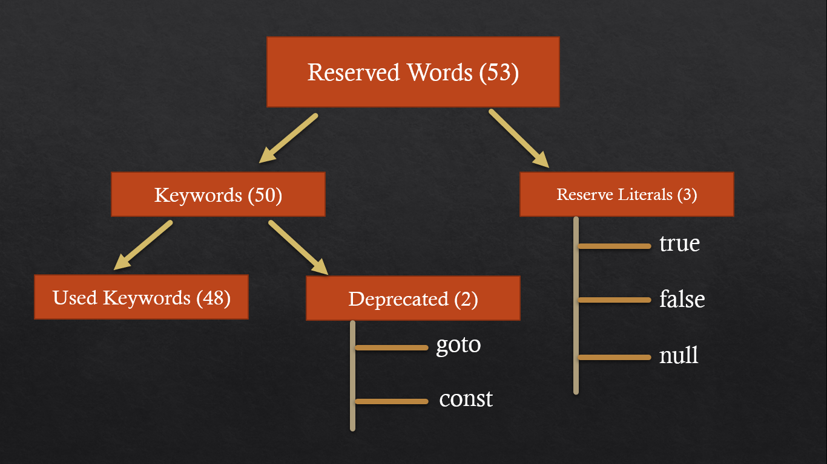
What Are Reserved Words ?

Slide 15
Important Points
const and goto are resevered words but not used.
true, false and null are literals, not keywords.
All keywords are in lower-case.

Slide 16
How To Check Keyword ?
Java allows us to check whether a word is a keyword or not
To do this , we have to call a static method called isKeyWord() of the class SourceVersion available in the package javax.lang.model
The prototype of the method is:
public static boolean isKeyword​(String s)

Slide 17
How To Check Keyword ?
import javax.lang.model.SourceVersion;
class TestKeyword {
public static void main(String[] args) {
String key = args[0];
if (SourceVersion.isKeyword(key)) {
System.out.println(key + " is a keyword");
} else {
System.out.println(key + " is not a keyword");
}
}
}

Slide 18
Popular Interview Question
1.Which of these can not be used for a variable name in Java?
A. Identifier
B. Keyword
C. Identifier & keyword
D. None of the mentioned
Correct Answer:
B

Slide 19
Popular Interview Question
2 Java is a ........... language.
A. weakly typed
B. strongly typed
C. moderate typed
D. None of these
Correct Answer:
B

Slide 20
Popular Interview Question
3. Which of the following is a legal identifier in java ?
A. 2variable
B. #myvar
C. +@$var
D. $_myvar
Correct Answer:
D

Slide 21
Popular Interview Question
4. Which of these is NOT a keyword in Java ?
A. default
B. null
C. strictfp
D. abstract
Correct Answer:
B

Slide 22
Popular Interview Question
5. Which is a valid keyword in Java?
A. interface
B. String
C. Float
D. unsigned
Correct Answer:
A

Slide 23
Popular Interview Question
6 .Which one of these lists contains only Java programming language keywords?
A. class, if, void, long, Int, continue
B. goto, instanceof, native, finally, default, throws
C. try, virtual, throw, final, volatile, transient
D. strictfp, constant, super, implements, do
E. byte, break, if, switch, include
Correct Answer:
B

Slide 24
Popular Interview Question
7. Which of the following is true of a Java bytecode file?
A. It can run on any computer with a compatible JVM.
B .It can only be executed on the same type of computer that it was created on.
C. It can be easily read and modified in a standard text editor.
D. It requires the corresponding .java that created it to execute.
Correct Answer:
A

Slide 25
Popular Interview Question
8. Which of the following is not a property of a JVM?
A. It prevents Java bytecode from being easily decoded/decompiled.
B. It supports platform independence.
C. It manages memory for the application.
D. It translates Java instructions to machine instructions.
Correct Answer:
A

Slide 26
Popular Interview Question
9. Which statement about the JVM is true?
A. The JVM schedules garbage collection on a predictable schedule.
B. The JVM ensures that no exception occurs in the code.
C. The JVM requires a properly defined entry point method to execute the application.
D. A Java compiled code can be run on any computer.
Correct Answer:
C

Slide 27
Popular Interview Question
10. Which of the following is a true statement?
A. The java command compiles a .java file into a .class file.
B. The javac command compiles a .java file into a .class file.
C. The java command compiles a .class file into a .java file.
D. The javac command compiles a .class file into a .java file.
Correct Answer:
B

Slide 28
Popular Interview Question
11. Structuring a Java class such that only methods within the class can access its instance variables is referred to as _______.
A. platform independence
B. object orientation
C. inheritance
D. encapsulation
Correct Answer:
D

Slide 29
Popular Interview Question
12. What is the output ?
public class Test{
int _$;
int $7;
int do;
public static void main(String argv[]){
Test test = new Test();
test.$7=7;
test.do=9;
System.out.println(test.$7);
System.out.println(test.do);
System.out.println(test._$);
}
}
A.7 9 0
B.7 0 0
C.Compiler error
D.Exception
E.None of these
Correct Answer:
C

Slide 30
Popular Interview Question
13 In Java, the word true is ................
A. keyword
B. literal
C.Same as value 1
D.Same as value 0
Correct Answer:
B

